Slide 1
Robotics 1 (2021-2022): 2nd Assignment

Slide 2
General Instructions:
From the Assignment 1 kinematic diagram of the following Mechanical Manipulators, obtain the D-H Parametric Table and write their respective codes in MATLAB online.
This is a group assignment.
The final outputs are the following:
3 D-H Parametric Tables with their labeled Kinematic Diagrams in a graphing paper
3 MATLAB scripts created thru laptop/desktop
Name your scripts in this format: Group#_Manipulator_laptop

Slide 3
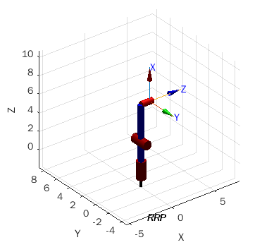
Spherical Manipulator - Modern Variant

Slide 4
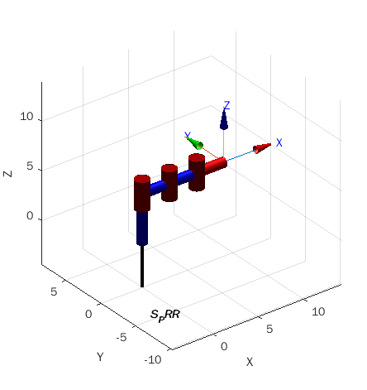
2. SCARA - PRR Variant

Slide 5
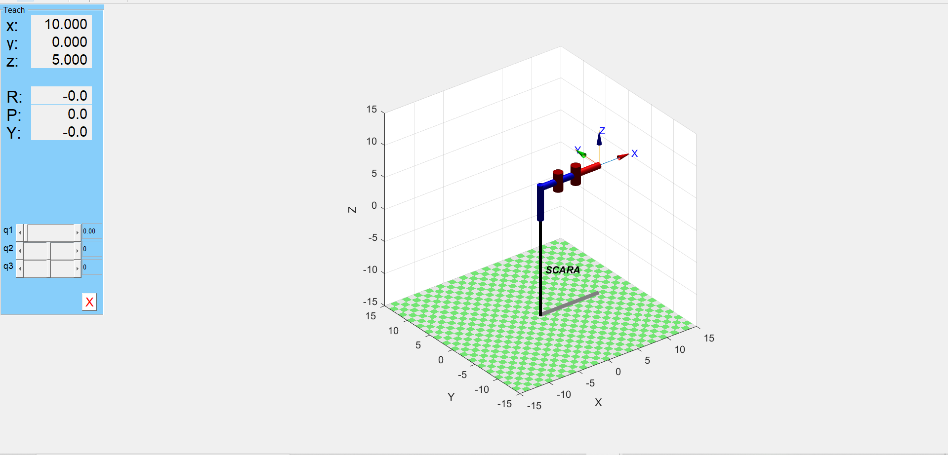
2. SCARA - PRR Variant (pwede ring ganito)

Slide 6
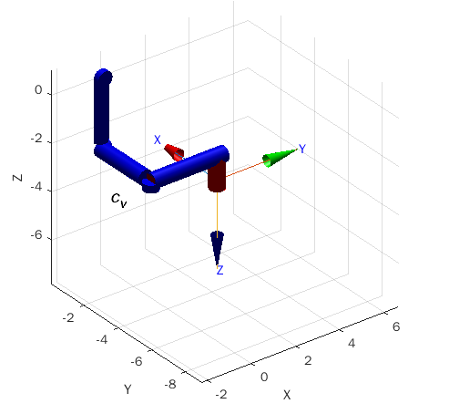
3. Cartesian Manipulator on Ceiling

